Slide 1

A Probabilistic Assessment of SARS-CoV-2 Host Interactions
in the Context of Meta-Community and Urban Ecology
Leman Nur Nehri
METU Biological Sciences
M Sci Student
Thesis Defence
29.06.2021

Slide 2
Outline
Introduction: Theoretical Background
Materials and Methods
Results
Discussion
Conclusion

Slide 3

Introduction:
Theoretical Background
Introduction: Theoretical Background
1.1 COVID-19 and SARS-CoV-2
1.1.1 COVID-19: Economical, sociological and technological aspects
1.1.2 Urbanism, climate change and SARS-CoV-2
1.1.3 Phylogeny, structure, and host interactions of SARS-CoV-2
1.1.4 Genome and proteins of SARS-CoV-2
1.2 Structure, function, and host interactions of Spike protein of SARS-CoV-2
1.2.1 Function and structure of Spike protein
1.2.2 Evolution and host interactions of Spike protein
1.3 Microbiome concept
1.3.1 Microbiomes and human microbiome
1.3.2 Gut microbiome
1.3.3 Gut microbiome and immune system
1.4 Research question
1.5 Modeling and in silico analysis
1.5.1 Constructing theoretical framework
1.5.2 Modeling the research design
1.5.3 Deterministic Programming vs Probabilistic Programming

Slide 4
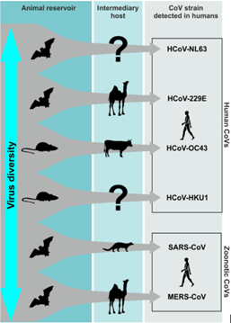
Introduction:
Theoretical Background
SARS-CoV-2 is a zoonotic (animal origin) virus transmitted from bat to human.
Figure 1. The summary of the CoV strained viruses and their transmission (Corman et al., 2018).

Slide 5
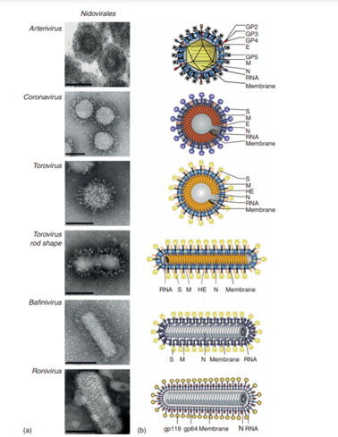
Introduction:
Theoretical Background
The structures of the nidoviruses are generally similar.
Figure 2. Structures of the nidoviruses (Enjuanes et al., 2006).

Slide 6
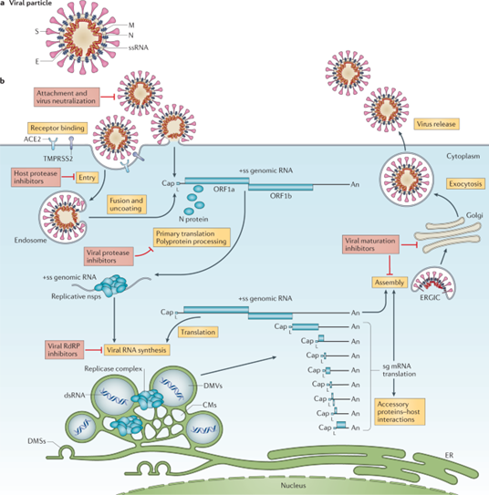
Introduction:
Theoretical Background
Spike protein attaches to ACE-2 receptor to enter virus to cell.
Figure 3. The viral cycle of the SARS-CoV-2 in a host cell (V’kovski et al., 2021).

Slide 7
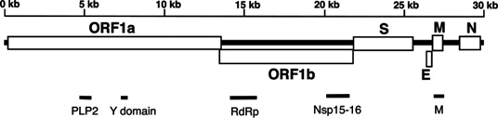
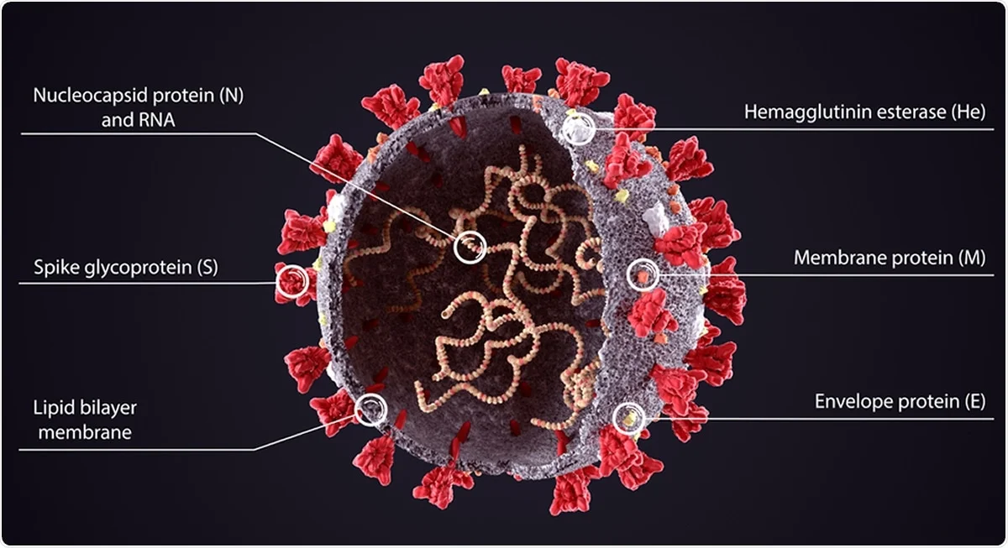
Introduction:
Theoretical Background
Figure 5. Schematic diagram of the SARS coronavirus genome (Wertheim et al., 2013).
The genome of SARS-CoV-2 codes 2 Open reading frames (Orfs) and 4 structural proteins.
Figure 4. Proteins of SARS-CoV-2 (Greenwood., 2021).

Slide 8
Introduction:
Theoretical Background
Figure 5. Schematic diagram of the SARS coronavirus genome (Wertheim et al., 2013).
Spike protein triggers most of the immune response.
Figure 4. Proteins of SARS-CoV-2 (Greenwood., 2021).

Slide 9
Introduction:
Theoretical Background
SARS-CoV-2
Variants of the virus
Spike protein
Mutants of the Spike protein

Slide 10
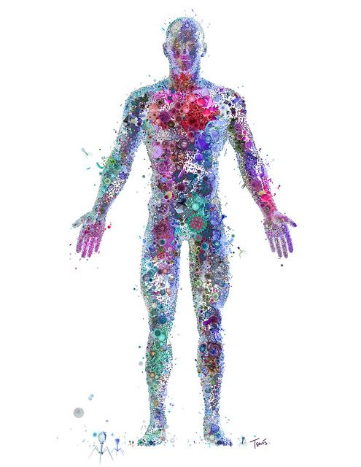
Introduction:
Theoretical Background
Gut microbiota plays an important role in immune response.
Figure 6. Microbiota representation (Google, 2021).

Slide 11
Introduction:
Theoretical Background
The main concern of this study is to try to understand whether particular gut microbiota compositions tolerate variants of the SARS-CoV-2 virus and Spike protein mutations of the virus.
In other words, it aims to investigate whether the bacterial composition of gut microbiota affects the infectivity of variants of SARS-CoV-2 and variants of Spike proteins.

Slide 12
Introduction:
Theoretical Background
Research question
Table 1.1 Hypotheses that are used in this study.
H1: | One of the following parameters can explain COVID-19 death and reproduction rates: Diet, diseases, economical parameters, environmental factors, micronutrient deficiencies, population parameters.
H2: | One of the following parameters can explain SARS-CoV-2 infectivity between variants and specifical mutations on Spike protein: Diet, diseases, economical parameters, environmental factors, micronutrient deficiencies, population parameters.
H3: | Microbes residing gut can explain which SARS-CoV-2 mutant infected the host.

Slide 13
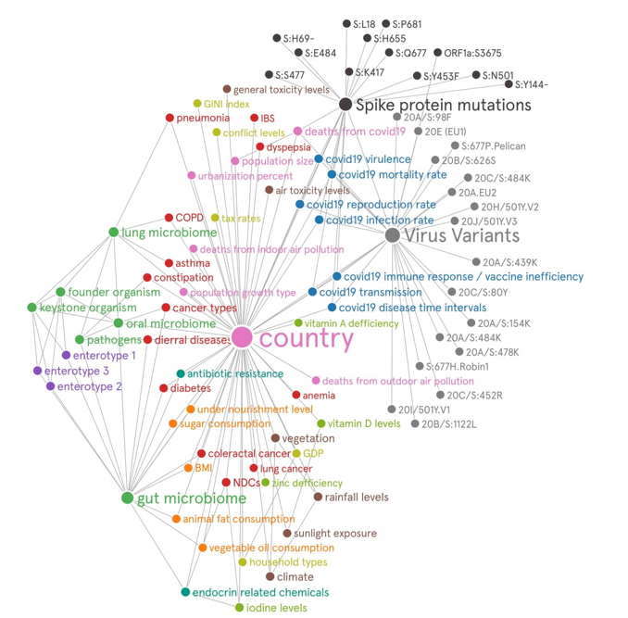
Introduction:
Theoretical Background
There is a wide variety of relationships between many individual parameters.
Figure 7. Relations that were used in this study.

Slide 14
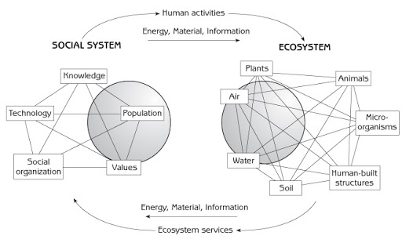
Introduction:
Theoretical Background
In this study, theories from the disciplines of microbial meta-community and urban ecology were used to unify these diverse relationships in a single context.
Figure 8. Interaction of the human social system with the ecosystem (Marten, 2001).

Slide 15
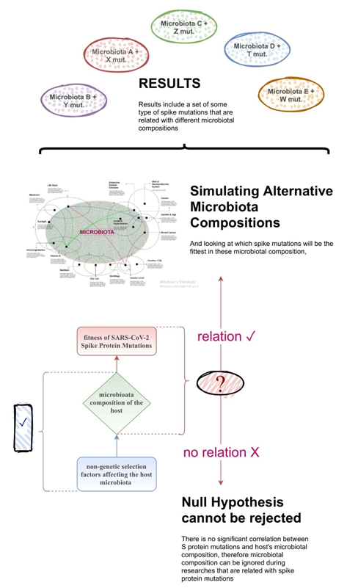
Introduction:
Theoretical Background
A research design was created to manage the process.
Figure 9. The schematic representation of the research design.

Slide 16
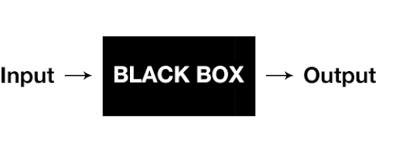
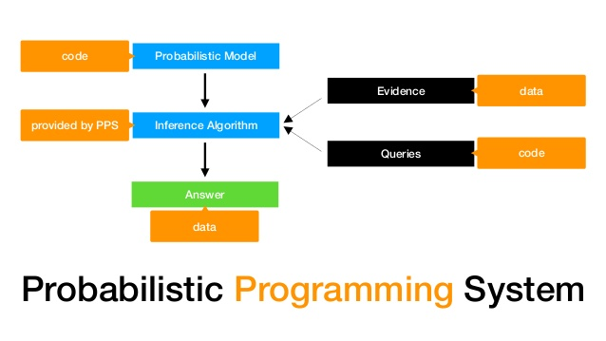
Introduction:
Theoretical Background
Figure 10. The schematic representation of the deterministic programming (Google Photos).
A deterministic interface was used in the initial analysis, and a probabilistic programming language (PPL) was used in the final analysis.
Figure 11. The schematic representation of the probabilistic programming system (Blum-Oeste, 2017).

Slide 17
Materials & Methods
2. Materials & Methods
2.1 Parameters
2.2 Data
2.2.1 Data of countries
2.2.2 Data of parameters
2.2.3 Data of SARS-CoV-2 variants and Spike protein mutant types
2.2.4 Microbiome data
2.3 Analysis
2.3.1 Softwares.
2.3.2 Set 1 analysis
2.3.3 Set 2 analysis
2.3.4 Set 3 analysis
2.4 Testing hypotheses

Slide 18
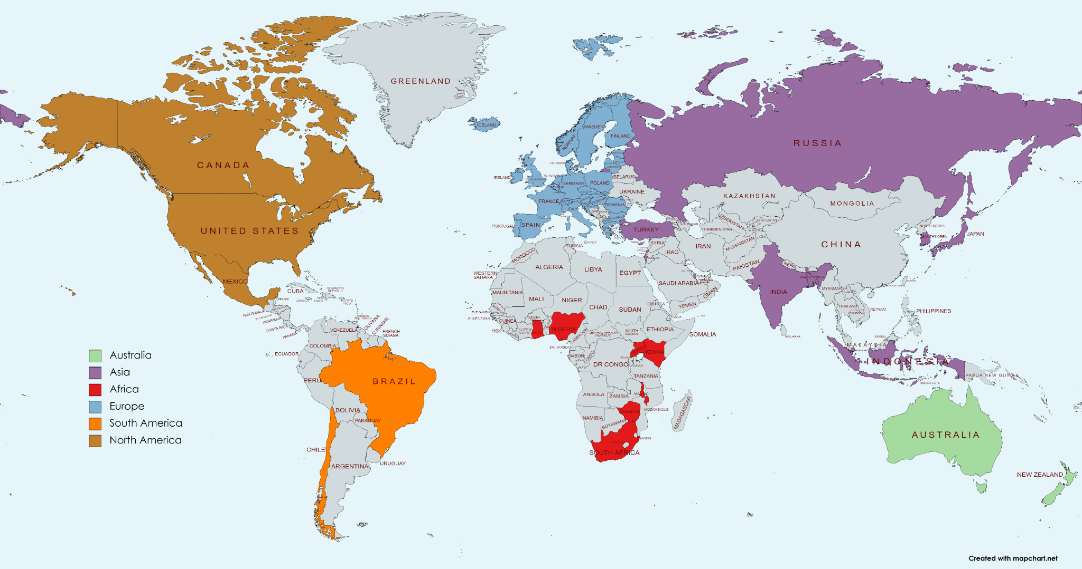
Materials & Methods
Data of countries
Data of 56 countries
and
Data of 15 variants of SARS-CoV-2 & 14 single mutations (13 Spike mutation, 1 Orf mutation) that are found in these 56 countries were used for analyzes.
Figure 12. The geographical distribution of the selected countries for the analysis from the GISAID database.
https://covariants.org/per-country
https://covariants.org/per-variant

Slide 19
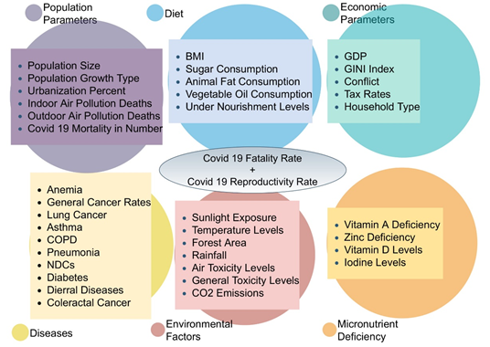
Materials & Methods
Data of Parameters
6 parameter sets that are containing 37 different data types for 56 country obtained for analyzes.
Figure 13. Representation of the selected parameter sets. The six sets of parameters are represented as a cluster and the dependent variables of the Set 1 Analysis (COVID-19 Fatality Rate and COVID-19 Reproductivity Rate) are represented as an ellipse. COVID19 reproduction rate shows the newly infected individuals by an infected person. If the rate is bigger than 1, the virus spread. If the rate is smaller than 1, the virus will gradually disappear from the population.

Slide 20
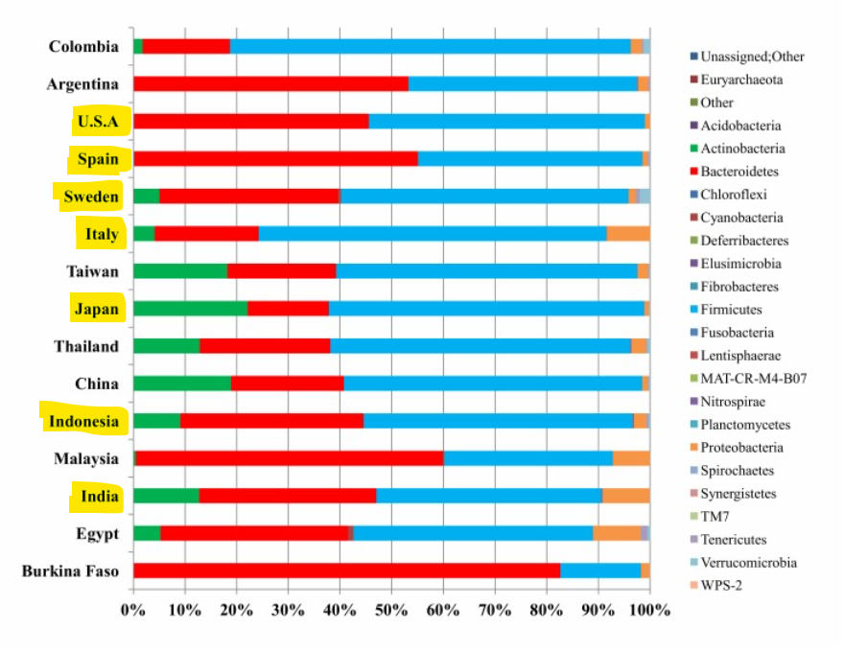
Materials & Methods
Microbiome Data
As microbiota data, bacterial distribution of gut microbiota in Mobeen's 2018 study (Mobeen et al., 2018) was used for 7 countries (Indonesia, India, Japan, Sweden, USA, Italy, Spain) for Set 3 Analysis.
https://www.ncbi.nlm.nih.gov/pmc/articles/PMC6563668/
Figure 14. The selected countries for the analysis and their microbial compositions (Mobeen et al., 2018)

Slide 21
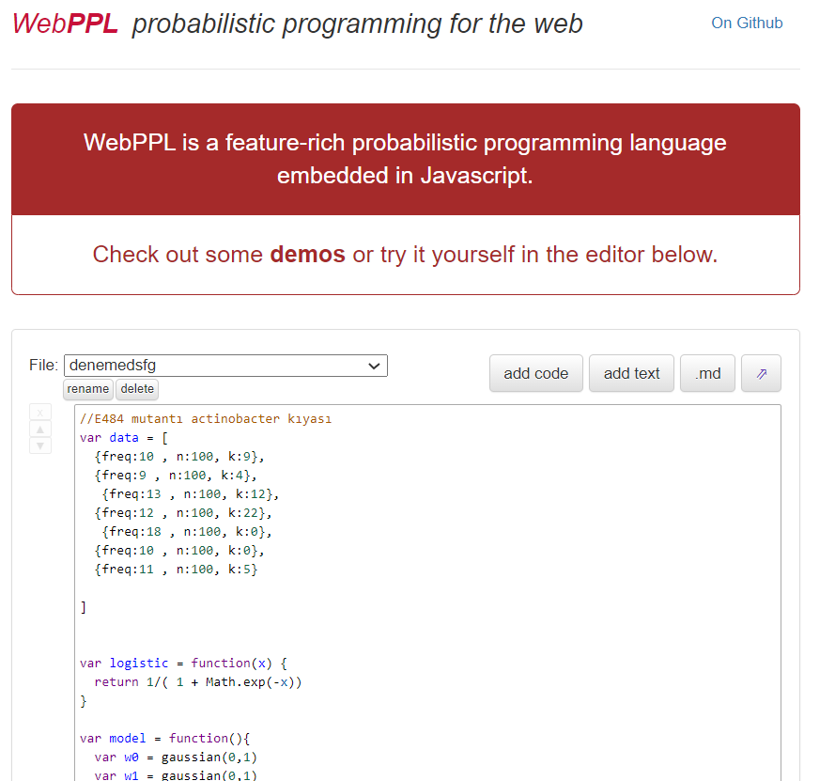

Materials & Methods
In this study, multi-linear regression, bivariate correlation, logistic regression analyzes and a parameter selection model were used.
Figure 15. The softwares that were used in this study.

Slide 22
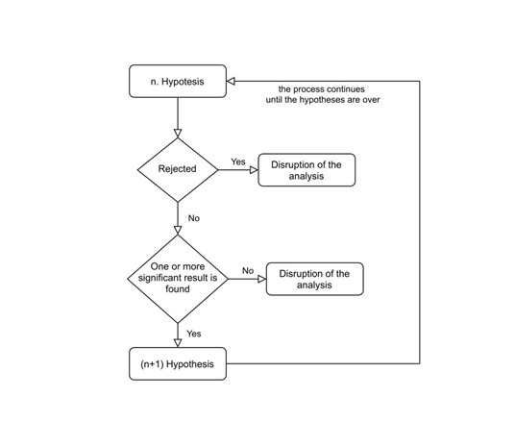
Materials & Methods
Testing hypotheses
Each group of analysis was dependent on the previous one.
Figure 16. Representation of hypotheses testing process as a flowchart.

Slide 23
Results
3. Results
3.1 Set 1 results
3.2 Set 2 results
3.3 Set 3 results

Slide 24
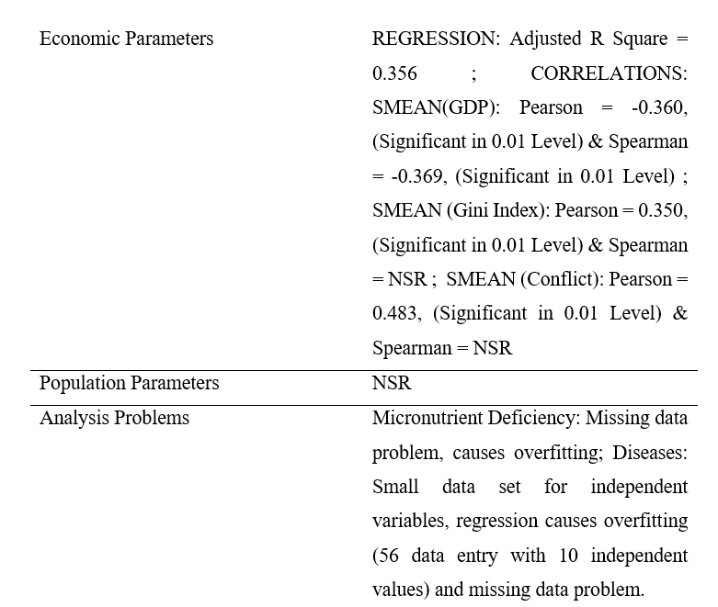
Results
3.1 Set 1 results
Hypothesis 1 (H1): One of the following parameters can explain COVID-19 death and reproduction rates: Diet, diseases, economical parameters, environmental factors, micronutrient deficiencies, population parameters.
Table 3.1 Regression and correlation analysis results of Set 1, for COVID-19 fatality rate (NSR= Non-significant result).

Slide 25
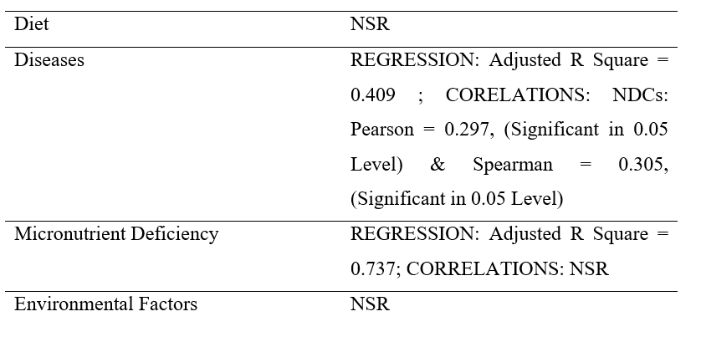
Results
3.1 Set 1 results
Hypothesis 1 (H1): One of the following parameters can explain COVID-19 death and reproduction rates: Diet, diseases, economical parameters, environmental factors, micronutrient deficiencies, population parameters.
Table 3.1 Regression and correlation analysis results of Set 1, for COVID-19 fatality rate (NSR= Non-significant result).

Slide 26
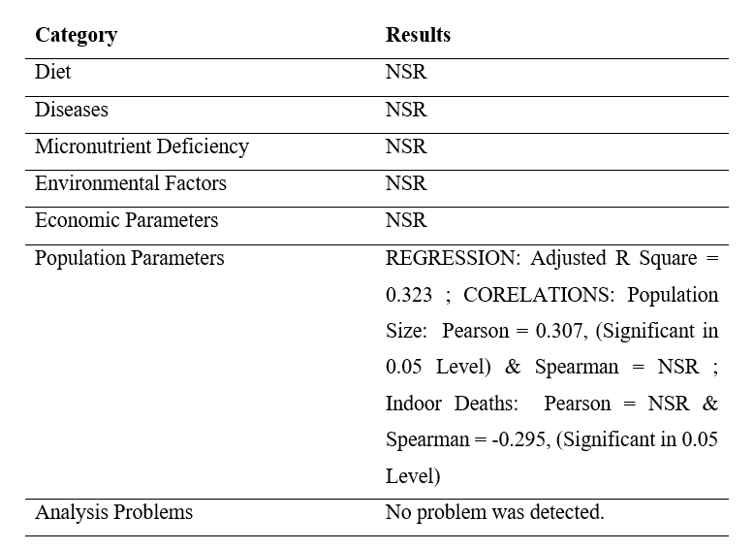
Results
3.1 Set 1 results
Hypothesis 1 (H1): One of the following parameters can explain COVID-19 death and reproduction rates: Diet, diseases, economical parameters, environmental factors, micronutrient deficiencies, population parameters.
Table 3.2 Regression and correlation analysis results of Set 1, for COVID-19 reproduction rate (Figure 2.1) (NSR= Non-significant result).

Slide 27
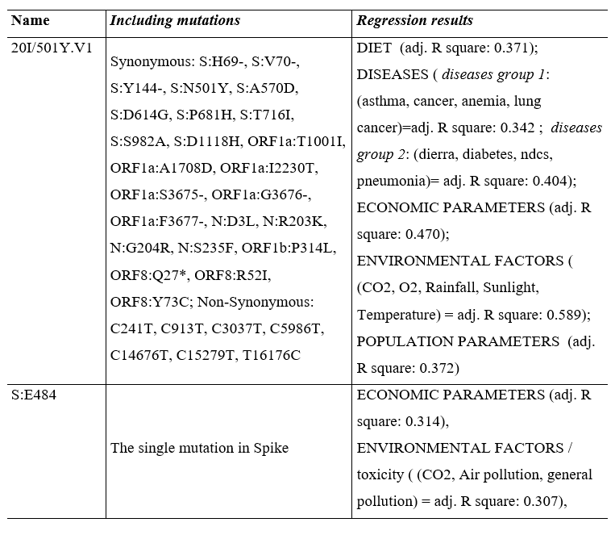
Results
3.2 Set 2 results
Hypothesis 2 (H2): One of the following parameters can explain SARS-CoV-2 infectivity between variants and specifical mutations on Spike protein: Diet, diseases, economical parameters, environmental factors, micronutrient deficiencies, population parameters.
Table 3.4 The regression results between Spike protein mutants and SARS-CoV-2 variants via parameter sets (Figure 2.1). The variable groups that were used as independent variables in multi-linear regression are stated in brackets.

Slide 28
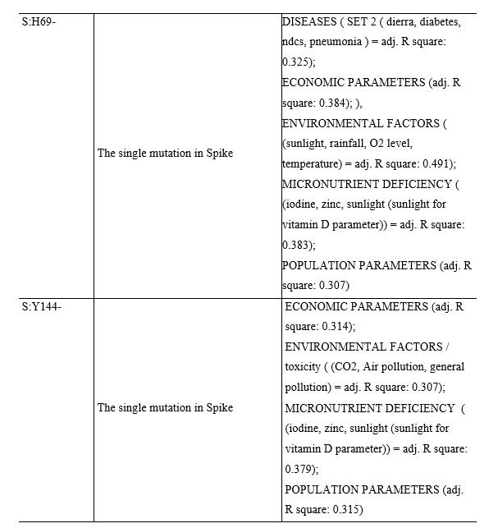
Results
3.2 Set 2 results
Hypothesis 2 (H2): One of the following parameters can explain SARS-CoV-2 infectivity between variants and specifical mutations on Spike protein: Diet, diseases, economical parameters, environmental factors, micronutrient deficiencies, population parameters.
Table 3.4 The regression results between Spike protein mutants and SARS-CoV-2 variants via parameter sets (Figure 2.1). The variable groups that were used as independent variables in multi-linear regression are stated in brackets.

Slide 29
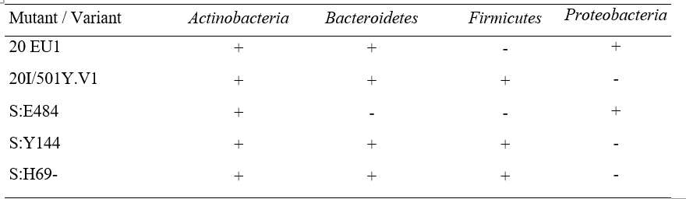
Results
3.3 Set 3 results
Hypothesis 3 (H3): Microbes residing gut can explain which SARS-CoV-2 mutant infected the host.
Table 3.5 Results of parameter selection model via logistic regression for microbiome bacteria and selected mutants and variants (Table 3.4). The positive logistic regression result is represented as + (plus) and the negative logistic regression result is represented as – (minus). 20 EU1 is added in Set 3 analysis due to be the control group of 20I/Y.V1.

Slide 30
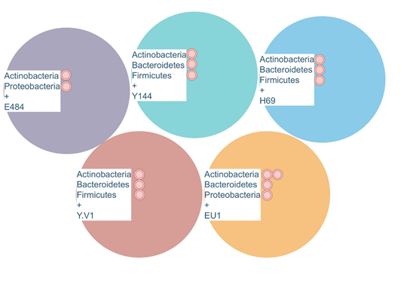
Results
3.3 Set 3 results
Hypothesis 3 (H3): Microbes residing gut can explain which SARS-CoV-2 mutant infected the host.
Figure 17. The resulted gut bacterial contents and related variants & S protein mutations. The red dots represent the regression probability densities.

Slide 31
Discussion
4. Discussion

Slide 32

Discussion
To sum up:
The study aimed to investigate whether the gut microbes can be selective parameters for SARS-CoV-2 variants and Spike protein mutants in humans.
Table 1.1 Hypotheses that are used in this study.
1
Set 1
Analysis
H1: | One of the following parameters can explain COVID-19 death and reproduction rates: Diet, diseases, economical parameters, environmental factors, micronutrient deficiencies, population parameters.
H2: | One of the following parameters can explain SARS-CoV-2 infectivity between variants and specifical mutations on Spike protein: Diet, diseases, economical parameters, environmental factors, micronutrient deficiencies, population parameters.
H3: | Microbes residing gut can explain which SARS-CoV-2 mutant infected the host.
2
3
Set 2
Analysis
4
5
Set 3
Analysis

Slide 33
Discussion
COVID-19 Spread vs Parameters
Hypothesis 1 (H1): One of the following parameters can explain COVID-19 death and reproduction rates: Diet, diseases, economical parameters, environmental factors, micronutrient deficiencies, population parameters.
Table 3.2 Regression and correlation analysis results of Set 1, for COVID-19 reproduction / spread rate (Figure 2.1) (NSR= Non-significant result).

Slide 34
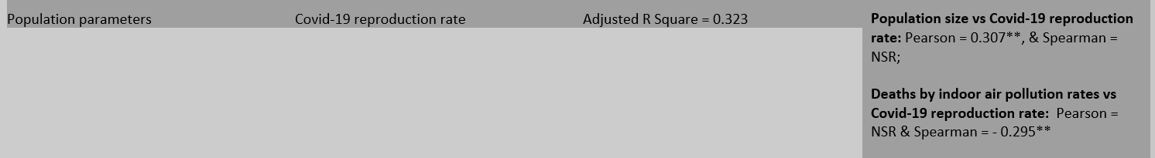
Discussion
Regression between COVID-19 Spread vs Population Parameters
It is known that the spread of SARS-CoV-2 is dependent on population structure such as population size and the median age of the population (Lulbadda et al., 2021) and the results of Set 1/COVID-19 reproduction rate is relevant to these results.
NSR = Non-significant result; *Significant in 0.01 level, **Significant in 0.05 level.
SMEAN(variable) = The missing values of the data ( null values in Table 1.) were detected by missing value analysis in SPSS, the significance of EM means was bigger than 0.05, therefore SMEAN variables created by replacing missing values by using the series mean of the data. The created SMEAN variables were used in the multi-linear regression analysis.

Slide 35
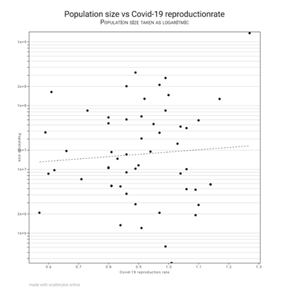
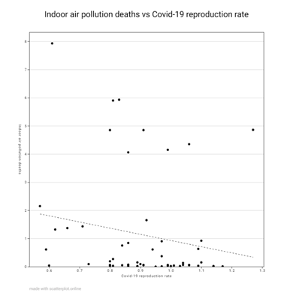
Discussion
Correlations between COVID-19 spread and population parameters
Figure 18. The correlations between COVID-19 reproduction rate and population size (left) and COVID-19 reproduction rate and indoor air pollution deaths (right).

Slide 36
Discussion
COVID-19 Fatality vs Parameters
Hypothesis 1 (H1): One of the following parameters can explain COVID-19 death and reproduction rates: Diet, diseases, economical parameters, environmental factors, micronutrient deficiencies, population parameters.
Table 3.1 Regression and correlation analysis results of Set 1, for COVID-19 fatality rate (NSR= Non-significant result).

Slide 37
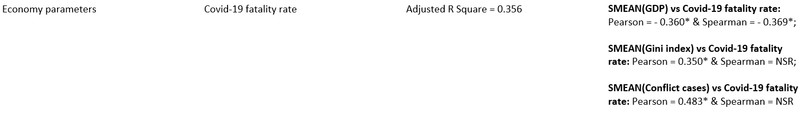
Discussion
Regression between COVID-19 Fatality vs Economic Parameters
The effort for constructing a linkage between the biological processes with the socio-economic process are common in many disciplines such as socio-biology (Hirshleifer, 1978) and urban ecology (Grimm et al., 2008b).
The results of Set 1 analysis for COVID-19 fatality rate (Table 3.1 and Table 3.2) support these efforts by giving a piece of evidence for showing that the economic parameters can explain COVID-19 deaths.
NSR = Non-significant result; *Significant in 0.01 level, **Significant in 0.05 level.
SMEAN(variable) = The missing values of the data ( null values in Table 1.) were detected by missing value analysis in SPSS, the significance of EM means was bigger than 0.05, therefore SMEAN variables created by replacing missing values by using the series mean of the data. The created SMEAN variables were used in the multi-linear regression analysis.

Slide 38
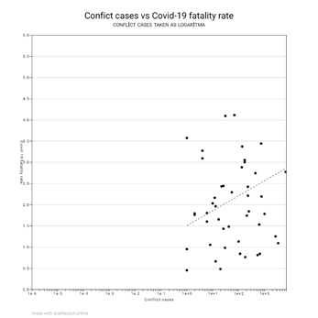
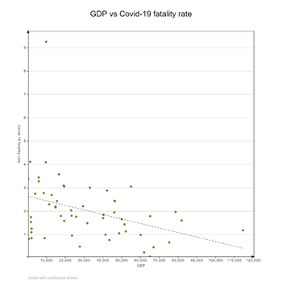
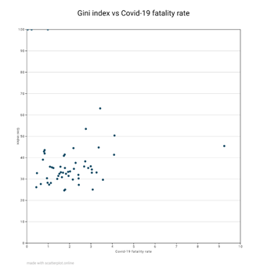
Discussion
Correlations between COVID-19 fatality and economic parameters
Figure 19. The correlations between COVID-19 fatality rate and Gini Index (left), COVID-19 fatality rate and Conflict Cases (middle), and COVID-19 fatality rate and GDP (right).

Slide 39
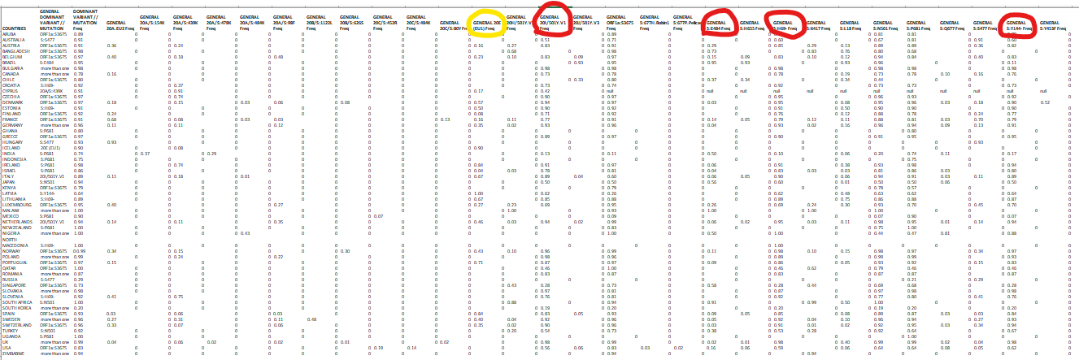
Discussion
Regressions between Sars-CoV-2 variants & Spike mutants vs Parameters

Slide 40
Discussion
Regressions between SARS-CoV-2 variants vs Parameters
Hypothesis 2 (H2): One of the following parameters can explain SARS-CoV-2 infectivity between variants and specifical mutations on Spike protein: Diet, diseases, economical parameters, environmental factors, micronutrient deficiencies, population parameters.
a variant of concern
5 of 6 parameter sets
Table 3.4 The regression results between Spike protein mutants and SARS-CoV-2 variants via parameter sets (Figure 2.1). The variable groups that were used as independent variables in multi-linear regression are stated in brackets.

Slide 41
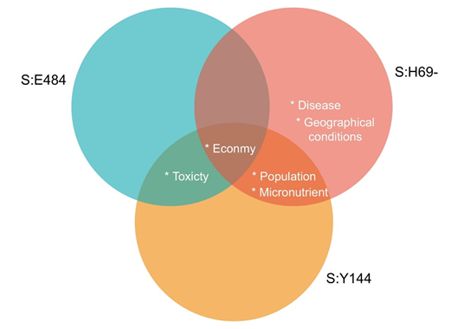
Discussion
Regressions between Spike protein mutations vs Parameters
Figure 20. The regression results between Spike protein mutants and parameter sets.

Slide 42
Discussion
Regressions between SARS-CoV-2 variants (2) and Spike protein mutations (3) vs Bacteria (4) of the gut microbiome
Hypothesis 3 (H3): Microbes residing gut can explain which SARS-CoV-2 mutant infected the host.
Table 3.5 Results of parameter selection model via logistic regression for microbiome bacteria and selected mutants and variants (Table 3.4). The positive logistic regression result is represented as + (plus) and the negative logistic regression result is represented as – (minus). 20 EU1 is added in Set 3 analysis due to be the control group of 20I/Y.V1.
variants
20 EU1:control
20I/501/Y.V1:experiment
Experiment
mutants

Slide 43
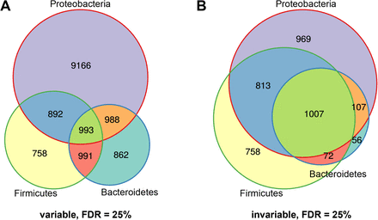
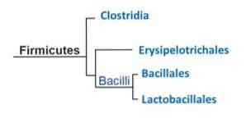
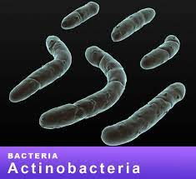
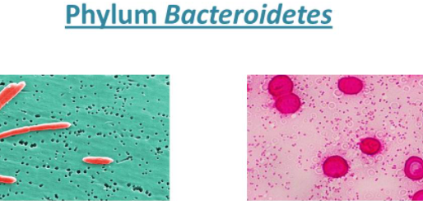
Discussion
FUNCTIONAL DIVERSITY
DOMINANT
DOMINANT
KEYSTONE
variants
20 EU1:control
20I/501/Y.V1:experiment
Experiment
mutants

Slide 44
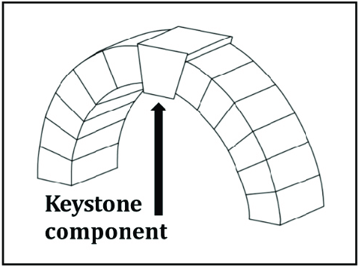
Discussion
FUNCTIONAL DIVERSITY
DOMINANT
DOMINANT
KEYSTONE
variants
20 EU1:control
20I/501/Y.V1:experiment
Experiment
mutants

Slide 45
Discussion
FUNCTIONAL DIVERSITY
DOMINANT
DOMINANT
KEYSTONE
variants
20 EU1:control
20I/501/Y.V1:experiment
Experiment
mutants

Slide 46
Discussion
FUNCTIONAL DIVERSITY
DOMINANT
DOMINANT
KEYSTONE
variants
20 EU1:control
20I/501/Y.V1:experiment
Experiment
mutants

Slide 47
Discussion
FUNCTIONAL DIVERSITY
DOMINANT
DOMINANT
KEYSTONE
variants
20 EU1:control
20I/501/Y.V1:experiment
Experiment
mutants

Slide 48
Discussion
FUNCTIONAL DIVERSITY
DOMINANT
DOMINANT
KEYSTONE
variants
20 EU1:control
20I/501/Y.V1:experiment
Experiment
mutants

Slide 49
Discussion
FUNCTIONAL DIVERSITY
DOMINANT
DOMINANT
KEYSTONE
variants
20 EU1:control
20I/501/Y.V1:experiment
Experiment
mutants

Slide 50
Conclusion
5. Conclusion
Although it was not analyzed in detail because of the problem of small data, the results can give an insight for the researchers to develop protective treatments against pathogens by enhancing the host microbiome.

Slide 51
Thank you!

Slide 52
Additional Slides

Slide 53
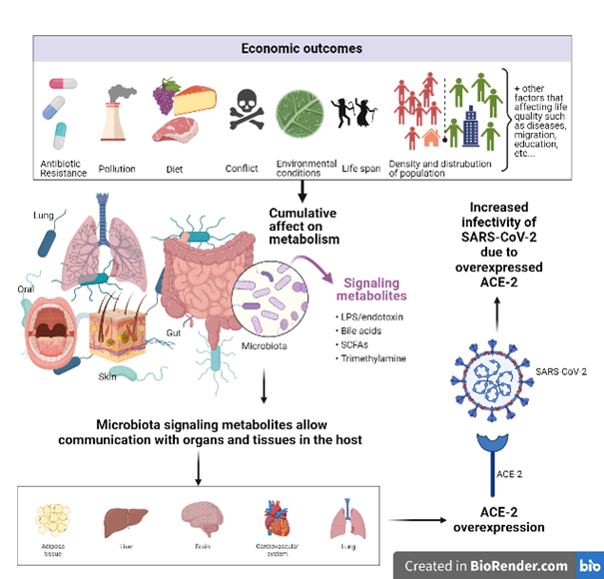
Why economy impact COVID-19 deaths?

Slide 54
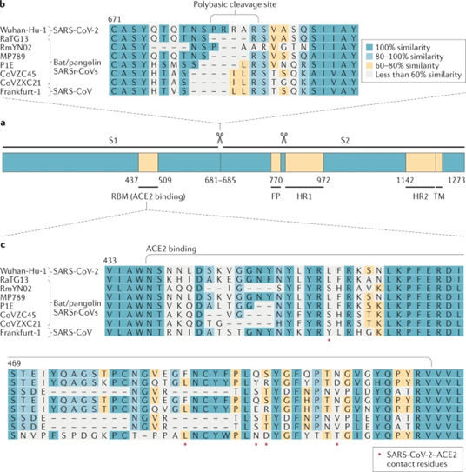
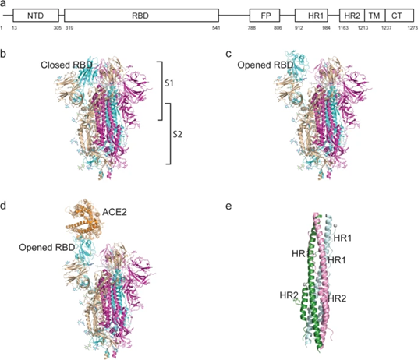
Spike protein
Figure 10. Schematic representation of the SARS-CoV-2 Spike protein (Y. Huang et al., 2020).
Figure 11. SARS-CoV-2 coronavirus spike sequence variation (V’kovski et al., 2021).

Slide 55
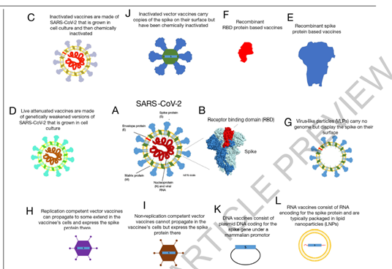
Vaccines
1.1.1 COVID-19: Economic, sociological and technological aspects
There are significant variations in COVID-19 susceptibility and severity/fatality from person to person (G. Anderson & Reiter, 2020).
A social transformation by affecting the human population in different aspects that can be categorized as economic, social, and technological (Mofijur et al., 2021).
Some newly popular vaccines for the disease are based on DNA & RNA technologies (Krammer, 2020).
The costs of the vaccines also have variants among the technologies, therefore there are vaccines for countries based on the levels of income (OECD Policy Responses to Coronavirus, 2021).
Figure 1. The vaccine types for COVID-19 (Krammer, 2020).

Slide 56
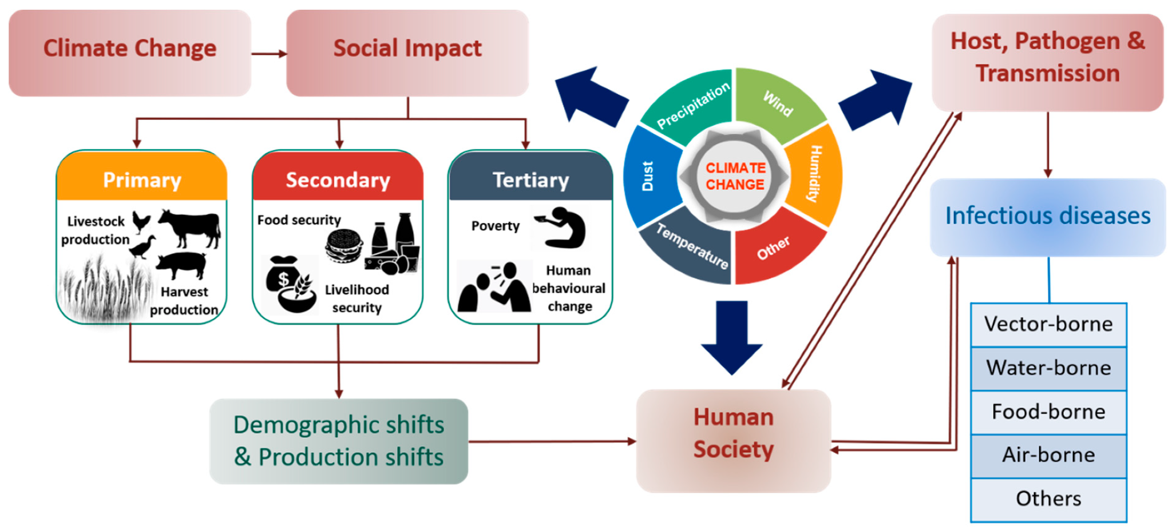
1.1.2 Urbanism, climate change and SARS-CoV-2
Climate change and urbanism
These activities changed the earth's ecosystem by contributing industrial chemicals to the atmosphere (Daly & Zannetti, 2007), destroying the floras and faunas, and decreasing biodiversity by human hands (Avise et al., 2009).
The changes in the ecosystems can be seen firstly in microorganisms (Singh et al., 2010).
Since the SARS-CoV-2 virus is a type of virus that is emerging from the areas of the interactions between rural and urban patches, this virus is an example of a microbe that emerged from human population and wild organism interactions (A. Banerjee et al., 2021).
Figure 2. Zootonic diseases with the ipact of Climate Change and Social Structure (Khan et al., 2019).

Slide 57
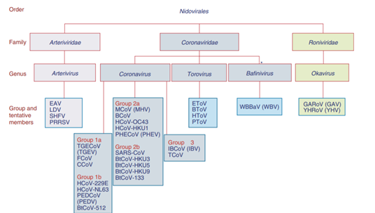
Introduction:
Theoretical Background
1.1.3 Phylogeny, structure, and host interactions of SARS-CoV-2
SARS-CoV-2 is an RNA virus belonging to the Nidovirales order Coronaviridae family) (Enjuanes et al., 2006).
Figure 4 Nidovirales order (Enjuanes et al., 2006).

Slide 58
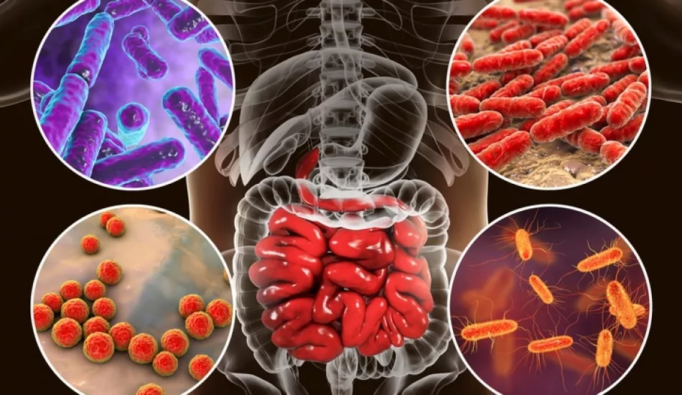
Introduction:
Theoretical Background
1.3.2 Gut microbiome
Enterotypes indicate a balanced relationship between the host and its microbiota (Arumugam et al., 2011).
The functional composition of different species is important for the intestinal microbiota (Arumugam et al., 2011; S. Banerjee et al., 2018). The human gut microbiome composition is affected by many factors.
Bacteroides are the dominant organisms of the gut microbiome in general, but in some enterotypes, Firmicutes can be the dominant organism (Arumugam et al., 2011; Mobeen et al., 2018; Trosvik & de Muinck, 2015). Actinobacteria is the keystone taxon of the gut microbiota. Proteobacteria is the species that represents and explains the functional variation that occurs in the gut microbiome among different microbe compositions (Bradley & Pollard, 2017).
Figure 13. Gut microbiome representation (Google, 2021).

Slide 59
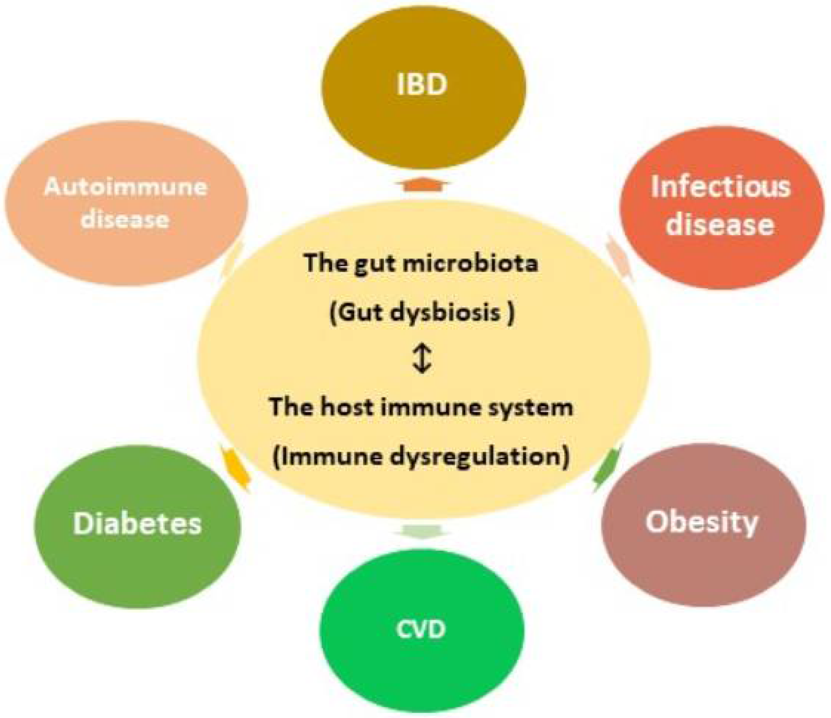
Introduction:
Theoretical Background
1.3.3 Gut microbiome and immune system
The gut microbiome is affected by diseases and also it affects the disease conditions: Rheumatoid arthritis, type 1 diabetes, inflammatory bowel disease (IBD), allergic diseases, systemic lupus erythematosus (SLE), skin-related autoimmune pathologies, neurological inflammatory diseases, and many cancer types can be counted among diseases related to gut microbiota (Lazar et al., 2018).
The composition of gut microbiota also changes during COVID-19 disease (Yeoh et al., 2021).
Gut microbiota prevents pathogen invasion by insisting on various strategies against pathogens such as killing pathogens directly, supporting the immune system of the host, or making competition for food (Pickard et al., 2017).
Figure 14. Gut microbiome immunity relation (Yoo, 2021).

Slide 60
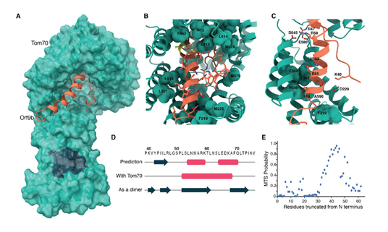
Introduction:
Theoretical Background
1.1.3 Phylogeny, structure, and host interactions of SARS-CoV-2
SARS-CoV-2 proteins are associated with some of the host proteins and make complexes and these complexes alter the effect of the virus on the host (D. E. Gordon et al., 2020).
For instance, a virus-host protein-protein interaction (PPI) formed by TOM-70 (a host cell membrane protein) and Orf-9b (a SARS-CoV-2 protein) is an example of this type of relation (D. E. Gordon et al., 2020).
Figure 7. CryoEM structure of Orf9b-Tom70 complex (D. E. Gordon et al., 2020).

Slide 61
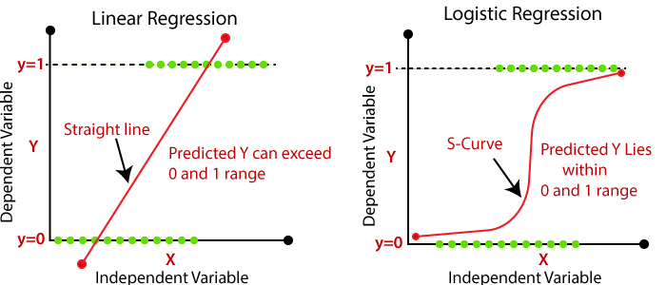
Materials & Methods
2.3 Analysis : Regression
Regression analysis was used with SPSS in the first two sets of analyzes since the data was big enough and has no overfitting problem. Logistic regression analysis was performed with probabilistic programming (WebPPL) in the third set of analyses since the data was small and caused an overfitting problem in SPSS.
Figure 24. Analysis models : linear and logistic regression (Japatpoint, no date).

Slide 62
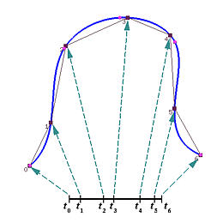
Materials & Methods
2.3 Analysis : Parameter Selection Model
In the Set 3 analysis, a logistic regression analysis was performed with the parameter selection model in WebPPL. The parameter selection model is an important model for data analysis (Mohamad et al., 2020).
Parameter selection is also a very important task in biological modeling since the selection of model parameters is crucial for measuring biological observations (Lillacci & Khammash, 2010).
Since the main question of this study is deciding whether there is a relation between SARS-CoV-2 mutants and variants (dependent variables) and bacterial microbiome contents of gut (independent variables), the parameter selection model was used as the model to investigate the relationship between selected variables.
Figure 25. Representation of parameter selection (Parameter Selection Overview, no-date).

Slide 63
Materials & Methods
2.3.1. Softwares
IBM SPSS Statistics version 26 was used for Set 1 and Set 2 analyses for multiple linear regression analysis and bivariate correlation analysis.
WebPPL ( http://webppl.org/ ), which is a JavaScript-based language and developed by cognitive scientists, suitable for small data sets with high expressive power, was used in Set 3 analyzes.
Figure 26. The softwares that were used in this study.

Slide 64
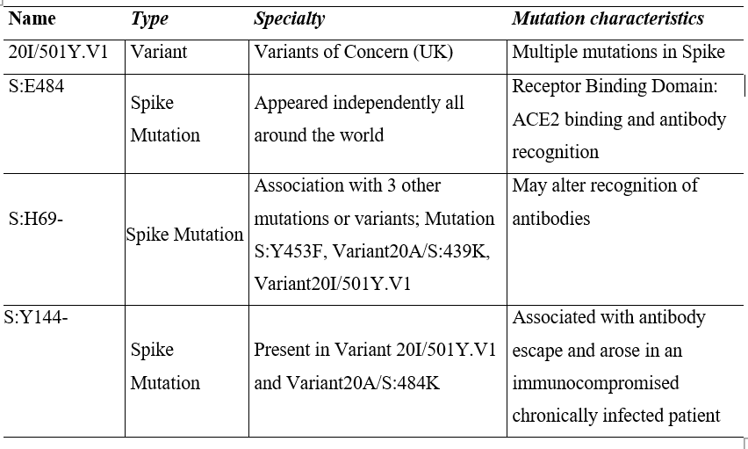
Results
Characteristics of Variant and Mutant
Table 3.3 The characteristics of the resulted Spike protein mutants and SARS-CoV-2 variants in Set 2 analysis.

Slide 65
Materials & Methods
2.1 Parameters
Diet: Diet is one of the main parameters that are related to COVID-19 deaths (Bousquet et al., 2020). Some types of diets show a relationship with COVID-19 deaths and COVID-19 cases (Greene et al., 2021).
Diseases: COVID-19 cases and COVID-19 fatality are related to many diseases: Among cancer patients, COVID-19 death rates are 13.3% higher than other patients (Moris et al., 2020), and some types of cancer patients are in the highest risk groups for COVID-19, such as lung cancers (Ömeroğlu Şimşek, 2020). Chronic obstructive pulmonary disease (COPD) and asthma are related to COVID-19 (Skevaki et al., 2021).
Economic Parameters: Economic statuses such as conflict, competition, and cooperation are linked with biology, especially with sociobiology, and the philosophical aspect of these connections have been constructed in literature (Hirshleifer, 1978).
Environmental Factors: Many environmental factors like temperature (Xie & Zhu, 2020; Xiong et al., 2020), sunlight (Asyary & Veruswati, 2020), open green area (Venter et al., 2020), whether factors such as rainfall (Hariyanto & Kurniawan, 2020; Tosepu et al., 2020), air toxicity (Travaglio et al., 2021), environmental pollutants (Bashir et al., 2020) are related with COVID-19 cases and COVID-19 deaths.
Micronutrient Deficiency: Micronutrients are minerals and vitamins that play important role in homeostasis by providing various functions in the body (Carr, 2020). Micronutrients are also important for the immune system to work properly and micronutrient deficiencies are related to COVID-19 also (Carr, 2020).
Population Parameters: Population size and the median age is related to COVID-19 spread (Lulbadda et al., 2021). It is also known that air pollution increases the risk of COVID-19 fatality (Ali & Islam, 2020).

Slide 66
Materials & Methods
2.2.2 Data of Parameters
https://docs.google.com/document/d/1d7mOUVuUl0aJ2wCLDgi7A5LCItF4zBsVuNBSV3QC21s/edit?usp=sharing

Slide 67
Materials & Methods
2.2.3 Data of SARS-CoV-2 variants and Spike protein mutant types
https://covariants.org/per-variant

Slide 68
Materials & Methods
2.3.2. Set 1 analysis
2.3.2. Set 2 analysis
Regression analyzes for COVID-19 fatality rate (dependent variable) and COVID-19 reproduction rate (dependent variable) in Set 1 analyzes were performed with SPSS multiple linear regression.
Regression analyzes for each variant of SARS-CoV-2 (dependent variable) and mutant of Spike protein (dependent variable) in Set 2 analyzes were performed using SPSS multiple linear regression.
2.3.2. Set 3 analysis
In Set 3 analyzes, logistic regression analyzes for the variants and mutants (dependent variables) obtained from Set 2 analyzes were performed using WebPPL. Microbiome data was used for independent variables for the selected 7 countries (Indonesia, India, Japan, Sweden, USA, Italy, Spain) (Mobeen et al., 2018).

Slide 69
Results
3.3 Set 3 results
Hypothesis 3 (H3): Microbes residing gut can explain which SARS-CoV-2 mutant infected the host.
Set 1 and Set 2 analyzes were analyzed with a program (SPSS) due to the sufficient data set size. However, in the hypothesis testing process, the data were generally eliminated at each stage and the data sets were getting smaller, therefore SPSS and deterministic programming languages were insufficient to analyze the data of Set 3. For instance, in Set 2 analysis, there are 18 variant types of SARS-CoV-2 and 11 Spike protein mutants but in Set 3 analysis only one type of SARS-CoV-2 variant and three types of Spike mutants have remained (Table 3.3). Therefore, the analyzes were made in the WebPPL for Set 3.
For 7 countries (Indonesia, India, Japan, Sweden, USA, Italy, Spain), gut microbe (Bacteroides, Firmicutes, Actinobacteria, and Proteobacteria) percentages were analyzed as independent variables, and the percent frequencies of selected mutants and variants were analyzed as a dependent variable by logistic regression model in WebPPL . https://docs.google.com/document/d/1qKhSb2cN9lUc8lrxx87CqNTcPy9NMvzGG3rZtiJJFlg/edit?usp=sharing

Slide 70
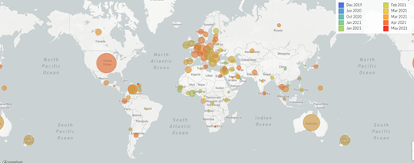
Discussion
20/501Y.V1 vs parameters (Set 2 Results)
The 20I/501Y.V1 variant emerged in the United Kingdom and spread throughout to world (To & Editor, 2021).
The dietary intake affects the human ACE2 receptor, the main target of the Spike protein, by affecting gene expression (Bhattacharya et al., 2021; Horne & Vohl, 2020). Therefore changing the ACE2 structure by dietary patterns can be linked with the results of Set 2 (Table 3.4).
Figure 28. The distribution of 20I/501Y.V1 variant (GISAID database).

Slide 71
Discussion
20/501Y.V1 vs parameters (Set 2 Results)
The regression value of diseases parameters and 20I/501Y.V1 variant was +0.371 (for asthma, cancer, anemia, lung cancer) and +0.342 (for diarrhea, diabetes, NDCs, pneumonia) (Table 3.4). Cronic diseases are related to SARS-CoV-2 cases and its severity (H. Liu et al., 2020).
The average age of Europe is also increasing, therefore the financial supply of the treatments of the chronic diseases is a problem for European countries (Brennan et al., 2017). Therefore, the regression relation with the results (Table 3.4) can be linked with the emergence of the 20I/Y.V1 variant in Europe.
Figure 28. The distribution of 20I/501Y.V1 variant (GISAID database).

Slide 72
Discussion
20/501Y.V1 vs parameters (Set 2 Results)
The regression value of economic parameters and 20I/501Y.V1 variant was +0.470, the regression value of environmental factors parameters and 20I/501Y.V1 variant was +0.589 and the regression value of population parameters and 20I/501Y.V1 variant was +0.372 (Table 3.4).
Figure 28. The distribution of 20I/501Y.V1 variant (GISAID database).

Slide 73




Discussion
20/501Y.V1 vs parameters (Set 2 Results)
No regression relation found between the 20I/501Y.V1 variant and micronutrient deficiency, which is common in only poor countries, not a global issue.
https://docs.google.com/document/d/1d7mOUVuUl0aJ2wCLDgi7A5LCItF4zBsVuNBSV3QC21s/edit#

Slide 74



Discussion
The prevalence of 3 mutants (Set 2 Results)

Slide 75

genome structures of nidoviruses
Enjuanes et. all, 2008

Slide 76

Genome organization of SARS-CoV

Slide 77

PPI map of host interactions
Comparative differential interaction analysis reveals shared virus-host interactions.

Slide 78

PPI Hot-spots of host interactions
Functional interrogation of SARS-CoV-2 interactors using genetic perturbations.

Slide 79

TOM-70 vs Orf9b

Slide 80

Spike protein compare
Enjuanes et. all, 2008

Slide 81

SARS-CoV-2 genome mutations
Breakpoints identified by 3SEQ., Boni et. all, 2020

Slide 82
Understanding the major evolutionary steps of the virus
S-protein & C-Terminal Domain
S protein phenotypes
S protein phylogeny
C Terminal phenotypes
C Terminal phylogeny

Slide 83

S protein phylogeny
Phylogenetic relationships among SARS-CoV-2 and closely related sequences for subregions of the S protein., Boni et. all, 2020

Slide 84

From Zhou, 2020
Overall structure of the SARS-CoV-2 N-CTD.
N terminal domain structure

Slide 85

C terminal domain comparisions
Structural comparison of N-CTDs from various CoVs and oligonucleotide-binding assay of the SARS-CoV-2 N-CTD.
From Zhou, 2020

Slide 86

C terminal phylogeny
Extended Data Fig. 1: Phylogenetic relationships in the C-terminal domain (CTD)., Boni et. all, 2020

Slide 87


Climate Change & Urbanism and COVID-19
Sharifi, 2020
C3S has built an app that explores the potential impact of temperature and humidity on COVID-19 deaths. From Copernicus Climate Change Service

Slide 88


Challenges deep-dive
Challenge 1
Challenge 2
Challenge 3
Microbial Circulations
Example: SARS-CoV-2
Food
Example: Pakistan
Energy
Example: Philippines
From Copernicus Climate Change Service
From USAID

Slide 89


B.1.1.7

Slide 90


Slide 91


Slide 92


Slide 93


Slide 94


Slide 95


